Slide 1
Principles of AI Engineering Chapter 3: Model Quality
Prof. Dr. Steffen Herbold
Credit:
Based on contents from Christian Kästner (https://github.com/ckaestne/seai)

Slide 2
Contents
What is model quality?
Model quality from a data science perspective
Evaluating generalization
Pitfalls of evaluations
Correctness from a software engineering perspective
Correctness of machine learning from a software engineering perspective
Learning from software testing
The oracle problem
Metamorphic testing
More software testing concepts

Slide 3
What is model quality?
Notes:
(8 min)

Slide 4
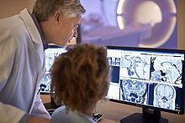
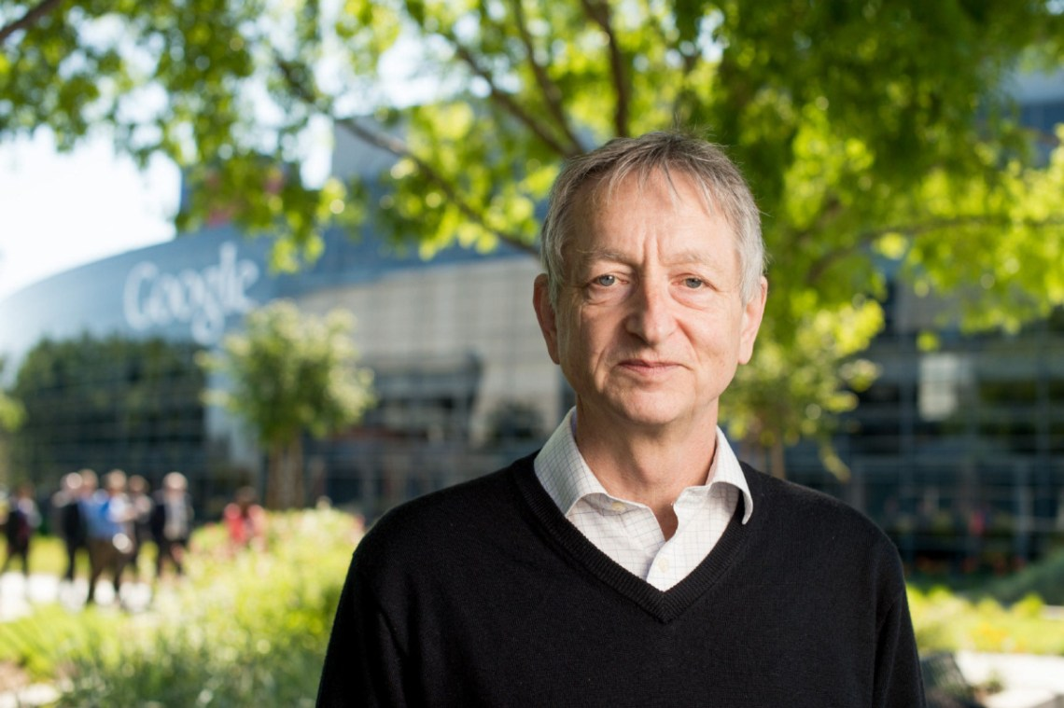
Case study: Cancer prognosis
We should stop training radiologists now. It‘s completely obvious that within five years deep learning is going to do better than radiologists.
https://www.youtube.com/watch?v=2HMPRXstSvQ&t=29s
Radiologist analyze MRIs and other medical data to understand cancer
This statement was made in 2016!
Geoffrey Hinton

Slide 5
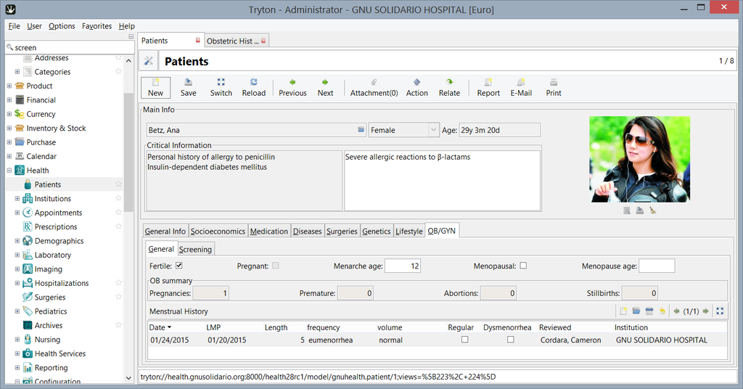
Model is part of a system in an environment
https://commons.wikimedia.org/wiki/Category:GNU_Health#/media/File:Gnu_health_2-8_gynocology_general.png

Slide 6
ML algorithm quality vs. model quality vs. data quality vs. system quality
Many aspects affect the overall quality!
ML algorithm quality
Is the ML algorithm implemented correctly and does it yield good results?
Model quality
Does the trained model yield correct results?
Data quality
Are there issues with the data used for training, validation, and testing?
System quality
Does the overall system fulfill the requirements?

Slide 7



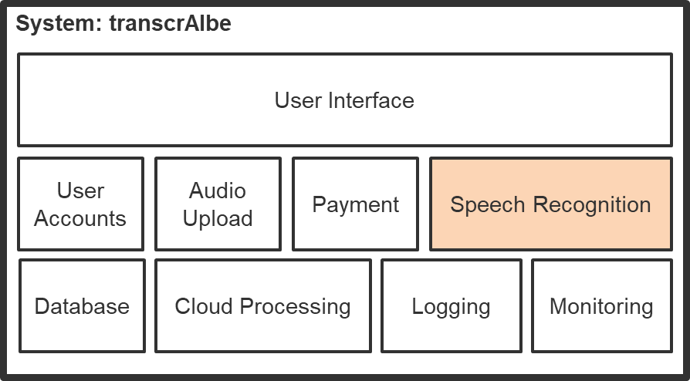
Model quality
Focuses only on the produced model
Checks quality, does not debug source (e.g., algorithm or data)!
Data
Algorithm
Model
→ Focus is on a small part of the overall system!

Slide 8


Some system-level aspects still important!
Usually derived from the use case
Example:
May not trust model
Radiologist uses model output
→ Human-in-the-Loop
Needs to explain diagnosis to patients

Slide 9
Many model qualities
Accuracy: How often are the predictions correct? Which mistake does the model make?
Model size: How large is the model?
Inference latency: How long do you need to wait for an inference (prediction)?
Learning latency: How long do you need to wait for a re-training to finish?
User interaction model: How can the model interact with users, resp. which interaction modes are supported?
Ability to incrementally learn: Can the model be easily be updated with new incoming data?
Explainability: Can the predictions be explained and how complex is the explanation?
Calibration: Can the model be tuned towards favoring certain aspects?
Robustness: Is the model robust against adversarial inputs?

Slide 10
Model quality from a data science perspective
Focus on accuracy
Notes:
(8 min)

Slide 11
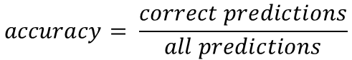
The confusion matrix
 | Actually Grade 5 Cancer | Actually Grade 3 Cancer | Actually Benign
Model predicts Grade 5 Cancer | 10 | 6 | 2
Model predicts Grade 3 Cancer | 3 | 24 | 10
Model predicts Benign | 5 | 22 | 82
$$accuracy= \frac{correct predictions}{all predictions}$$
$$accuracy= \frac{10+24+82}{10+6+2+3+24+10+5+22+82}=0.707$$

Slide 12
Model quality with respect to system goals
Suppose you have two models for the same task
Which model supports the system goals best?
Which one makes fewer important mistakes?
Which one is easier to operate?
Which one is better overall?
Is either one good enough?!
Live exercise: How would you evaluate this for the cancer prognosis example?

Slide 13
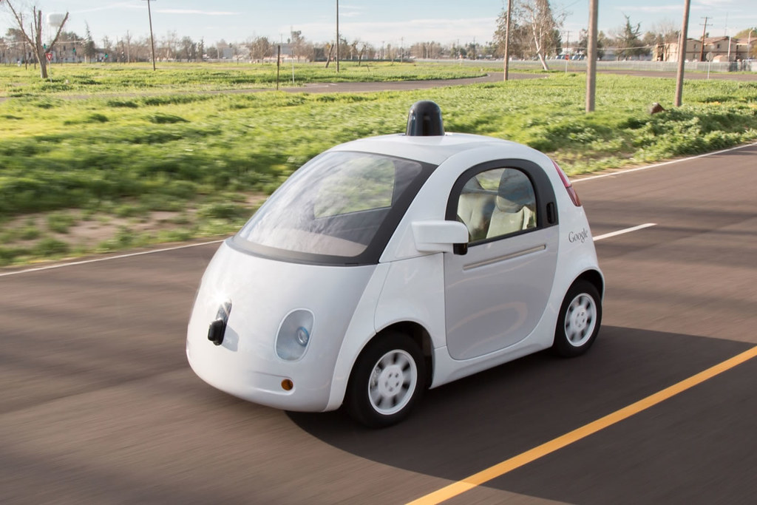

99% accuracy = good? 10% accuracy = bad?
Depends!
Object detection of other people on the road for a self-driving car?
99% is bad!
Information retrieval task like a search engine?
10% is good (as long as relevant hits are contained and ranked high)

Slide 14

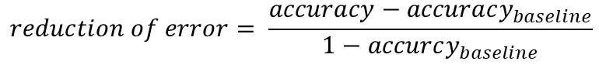
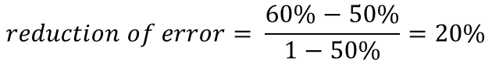
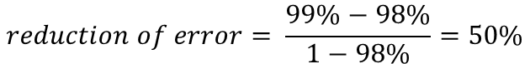
Is 1% improvement good?
Depends!
From 98% to 99%?
From 50% to 60%?
Calculate improvement over baseline:
$$reduction of error= \frac{accuracy−accuracy_{baseline}}{1−accurcy_{baseline}}$$
$$reduction of error= \frac{99\%−98\%}{1−98\%}=50\%$$
$$reduction of error= \frac{60\%−50\%}{1−50\%}=20\%$$

Slide 15







Possible baselines
Random prediction
Everything true
Everything false
Repeat last observation
Simple heuristic
E.g., threshold on single feature
Simple model
E.g., logistic regression
State-of-the-art model

Slide 16
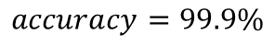
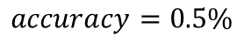
Do not forget event likelihood!
Not every event is likely to happen
About 1 in 2,000 has cancer
Random model
Never cancer
 | Actually Cancer | Actually No Cancer
Model predicts Cancer | 3 | 4998
Model predicts No Cancer | 2 | 4997
 | Actually Cancer | Actually No Cancer
Model predicts Cancer | 0 | 0
Model predicts No Cancer | 5 | 9995
$$accuracy=0.5\%$$
$$accuracy=99.9\%$$
https://gis.cdc.gov/Cancer/USCS/DataViz.html

Slide 17

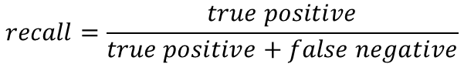
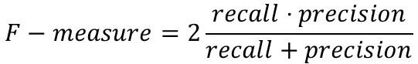
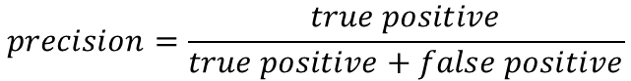
Different metrics = Different perspectives
Recall measures hit rate of positive predictions
$$recall=\frac{true positive}{true positive+false negative}$$
Precision measures noise within positive predictions
$$precision=\frac{true positive}{true positive+false positive}$$
F-measure combines both through the harmonic mean
$$F−measure=2\frac{recall⋅precision}{recall+precision}$$
Many more!
AUC, TPR (=Recall), TNR, FNR, FPR, MCC, Log loss, …

Slide 18
Baselines, Recall, and Precision
Predict everything as true
Recall =
Precision =
Prediction everything as false
Recall =
Precision =
Predict everything randomly
Recall =
Precision =
1
Low value (depends on percentage of false)
0
Undefined
approx. 0.5
approx. 0.5

Slide 19
Live exercise: Are false positives and false negatives equally bad?
Recognizing cancer
Suggesting products to buy on e-commerce site
Identifying human trafficking at the border
Predicting high demand for ride sharing services
Approving loan applications
What is better? No answer or the wrong answer

Slide 20

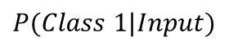
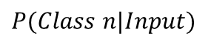
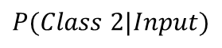
Thresholds for certainty
$$P(Class 1|Input)$$
$$P(Class 2|Input)$$
…
Input
Model
$$P(Class n|Input)$$
Common approach: assign class with highest probability
Alternative: require probability above a certain threshold

Slide 21
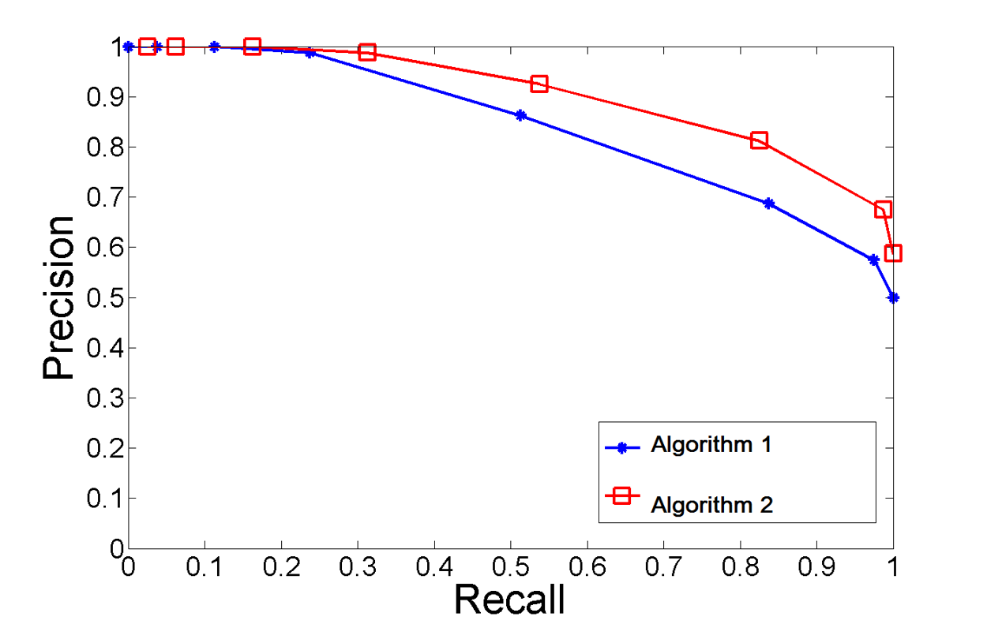
Visual aids to decide thresholds
Test different thresholds and plot the recall and precision that were achieved
Also common: Receiver Operator Characteristic (ROC) as curve of TPR vs FPR

Slide 22
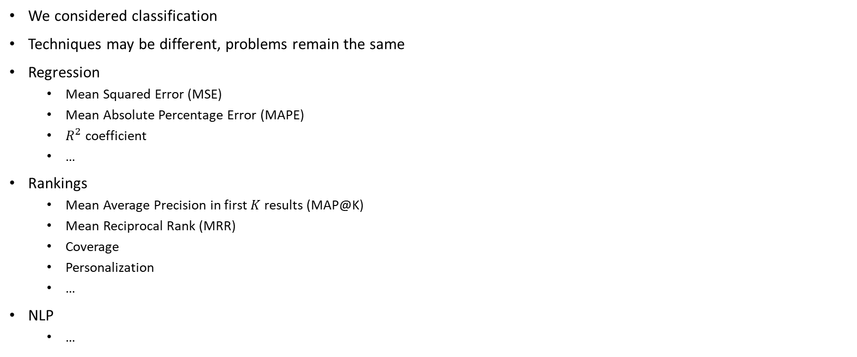
Different but same for other techniques
We considered classification
Techniques may be different, problems remain the same
Regression
Mean Squared Error (MSE)
Mean Absolute Percentage Error (MAPE)
$R^{2}$ coefficient
…
Rankings
Mean Average Precision in first $K$ results (MAP@K)
Mean Reciprocal Rank (MRR)
Coverage
Personalization
…
NLP
…
Which metric?
What does this mean for my use case?
What does this mean for my model?
What is a good baseline for comparison?

Slide 23
Evaluating generalization
Notes:
(8 min)

Slide 24


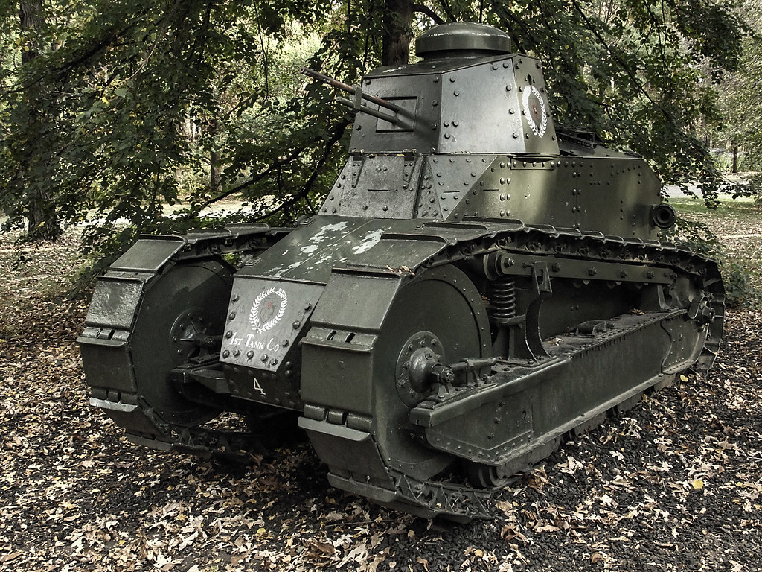
Researchers tried to identify tanks hidden in a forest…
Label: no tank
Label: tank
… it worked during training …
… but failed with new pictures …
… because the algorithm learned something else!
Learned concept: not sunny
Learned concept: sunny
This is an unconfirmed urban machine learning legend!

Slide 25
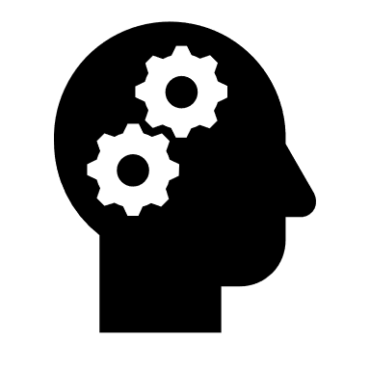
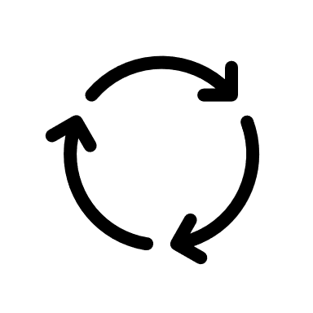

Training data, validation data, test data
Use only once!
Training data
Learning algorithm
Candidate model
Final model
Test data
Note: Training, validation, and test data are not overlapping!
Validation data
Estimated performance
Other variants for training/validation:
Leave-one-out cross validation (Jackknife)
k-fold cross-validation
Repeated bootstrap samples
→ Not possible with test data!
Hyperparameter tuning
Validation performance

Slide 26
Model parameters vs hyper parameters
Model parameters
The internal parameters that a model learns based on data
Weights, coefficients, boolean conditions, …
Software engineering view:
Constants of the learned function
Hyper parameters
The parameters that configure the algorithm that learns the model
Number of neurons, layers, tree depth, …
Software engineering view:
Arguments of the learning algorithms interface
Optimized on training data
Optimized on validation data

Slide 27
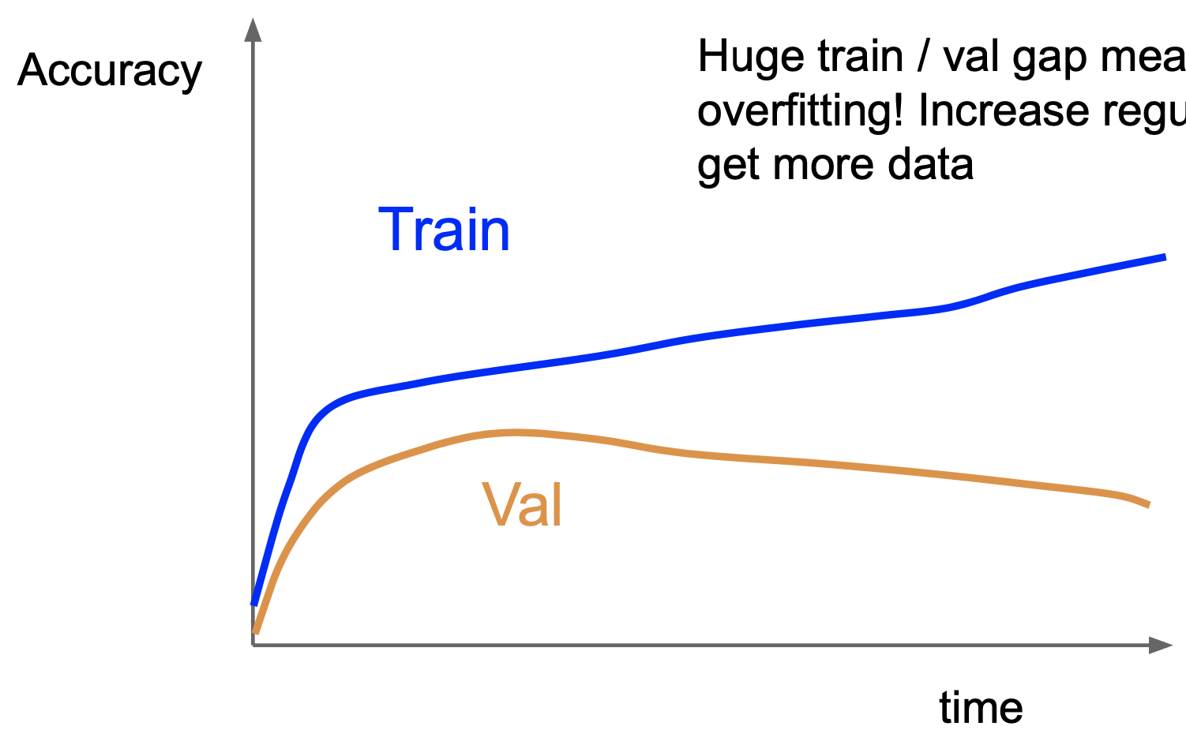
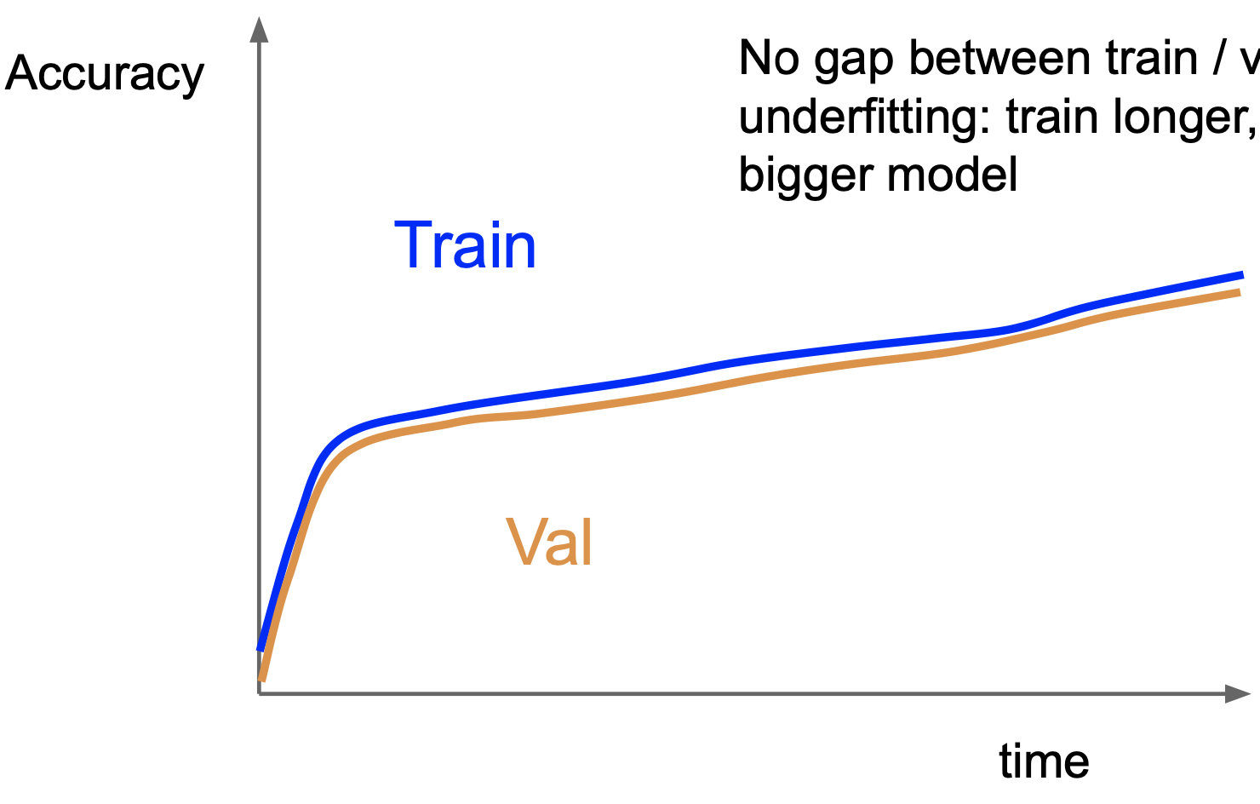
Overfitting and underfitting
Overfitting
Model learned exactly for the input data, but does not generalize to unseen data
Example: exact memorization
Underfitting
Model makes very general observations that work on training data but poorly fits to other data
Example: Pictures with tanks are brighter
Overfitting
Underfitting
Memorizes training data (gets better)
Stops generalizing to other data (gets worse)
Model works equally (bad) on training and test data

Slide 28
Live exercise
What can you do if your model overfits?
What can you do if your model underfits?

Slide 29
Pitfalls of evaluations
Notes:
(8 min)

Slide 30
Test data not representative
All data
Target data
E.g. radiology images for lung cancer
Available data
E.g., data from one hospital
Live exercise: What are reasons why the available data for the cancer prediction use case may not be representative?

Slide 31
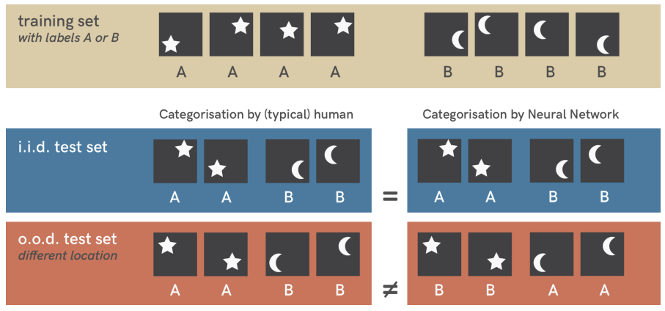
Shortcut learning
Stars: top-right, bottom-left
Moons: top-left, buttom-right
Shortcut!
Location is easier than shape
Geirhos, Robert, Jörn-Henrik Jacobsen, Claudio Michaelis, Richard Zemel, Wieland Brendel, Matthias Bethge, and Felix A. Wichmann. "Shortcut learning in deep neural networks." Nature Machine Intelligence 2, no. 11 (2020): 665-673

Slide 32
Problems with representativeness in practice
Target distribution may not be known in early stages of the project
Production data is the best test data
Requires knowledge about what production looks like
Sometimes only available after deploying initial system!
Target distribution may shift over time
Concept drift!
Monitoring and continuous data collection are important!

Slide 33
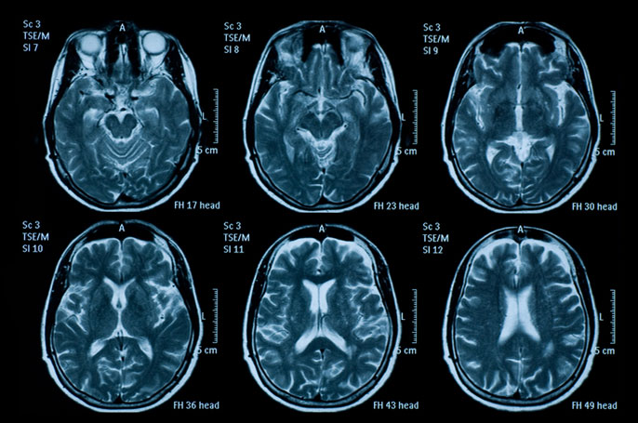
Label leakage in images
Label leaked by sunlight
Label often leaked by metadata

Slide 34
Label leakage
Label (or close correlates) included in inputs
Examples:
Input: “interview conducted” in turnover prediction encode human judgement
Input: “has bank account” associates with predicting whether somebody will open one
Live exercise:
Is label leakage always bad?
Be cautious of results that are too good to be true!

Slide 35
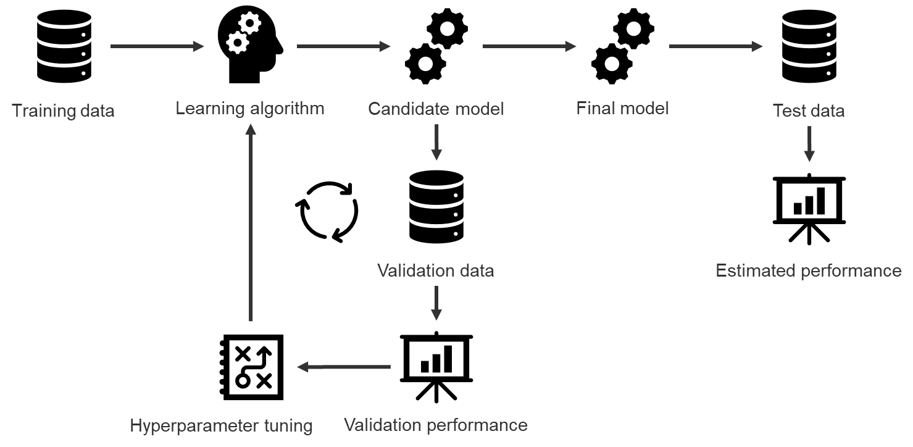
Overfitting on benchmarks
Used many times!
Degenerates to validation data!
Published model
Review process

Slide 36
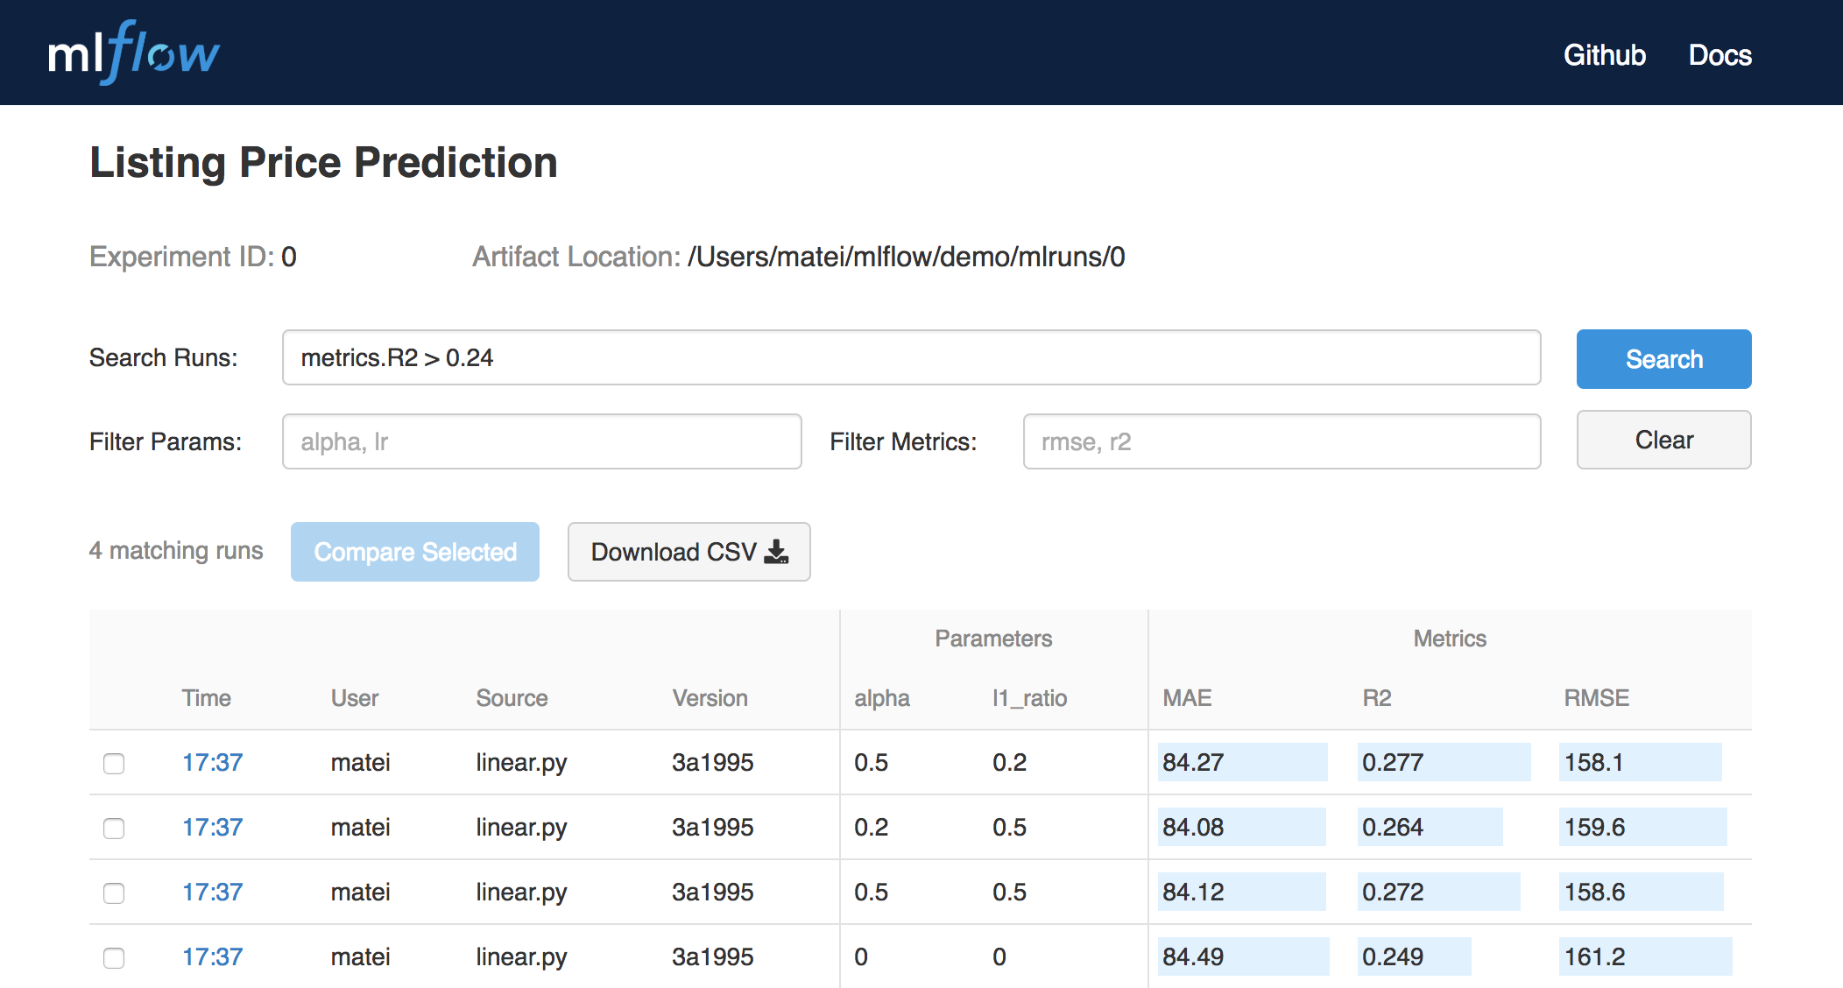
Overfitting in continuous experimentation systems
Part of MLOps to monitor performance of different models before serving
Test data needs to be changed often!
Degenerates to validation data otherwise!
Use statistics to estimate when new data needs to be used.

Slide 37
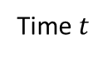
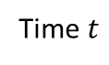
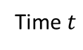
Ignoring temporal dependencies
Data over time
Time $t$
How can we split this into training, validation, and test data?
Good
Bad
Time $t$
Time $t$
Future predicts past!

Slide 38

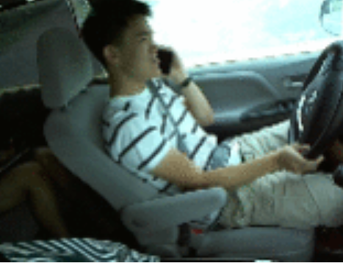
Related datapoints
Can be subtle issues!
Pictures of the same person (as above)
Sales from the same user
Pictures taken on the same day
https://www.kaggle.com/c/state-farm-distracted-driver-detection

Slide 39
Using misleading quality measures
Using accuracy when costs of errors are different for false positives and false negatives
Using the area under a curve of all possible thresholds, instead of only considering relevant thresholds
Using global averages when risks and costs are different for subgroups of data
Using old test data to calculate metrics
Using very small validation and test sets
Reporting results without suitable baselines
Considering only gains (e.g., in recall), without considering related losses (e.g., precision)
…

Slide 40
Correctness from a software engineering perspective
Notes:
(8 min)

Slide 41
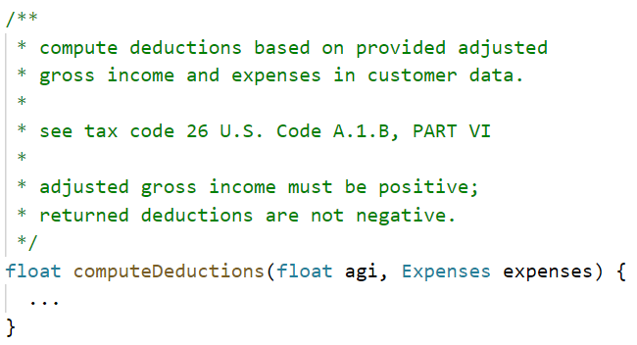
Functional correctness
Given specification, do outputs match input?
Each mismatch is considered a bug and should be fixed
Not economic to fix every bug, depends on cost of fix and cost of bug!

Slide 42
Verification vs. validation
Problems and needs
Requirements engineering
Validation
Specification / Requirements
Verification
Coding
Implementation

Slide 43


Validation problem: Correct but useless?
Specification implemented correctly …
… but the specification was wrong
Created system is not what the user needs
Often: bad, missing, or wrong assumptions about how the system is used

Slide 44
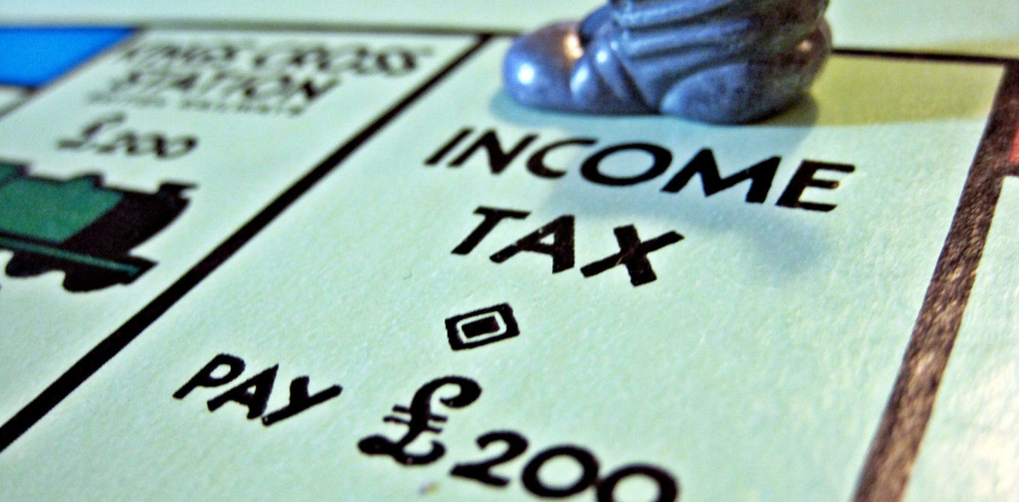
Strict correctness assumption
Specification determines which outputs are correct/wrong
Binary! Not pretty good, 95% accurate, or correct for 98% of the users
Single wrong results is a bug
Application calculates taxes
You pay calculated amount
If it is wrong and too little, you are in trouble!
Bug!

Slide 45
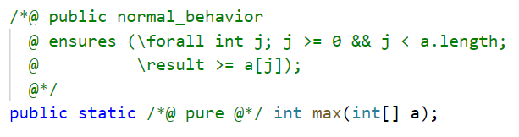
Ideally: Formal specification
Example: Specifying the behavior with Java Modeling Language (JML)

Slide 46
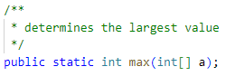
In practice: Informal and incomplete specifications
Example: natural language comment specifies behavior
Live exercise: Why is this specification incomplete?

Slide 47
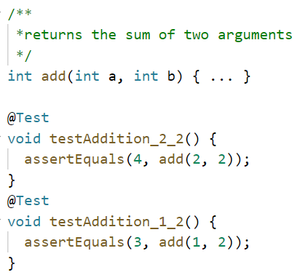
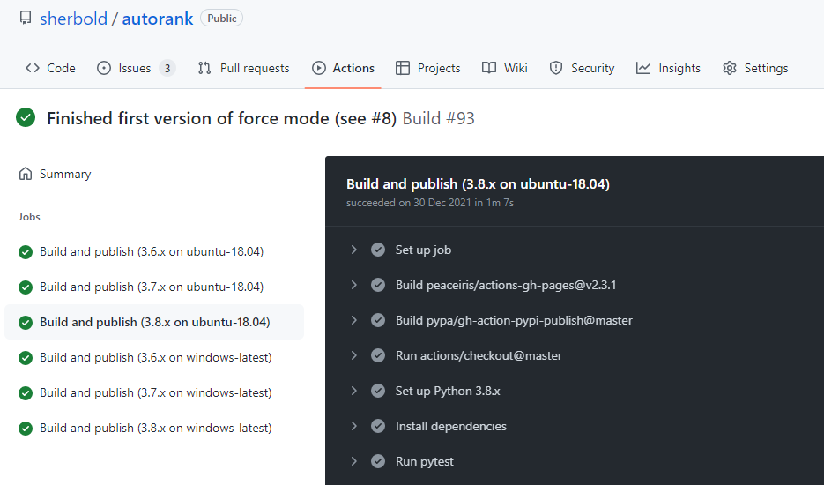
Common practices: Testing, automation, continuous integration
Write automated unit tests
Execute them automatically for each change

Slide 48
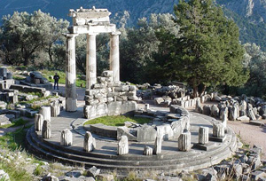

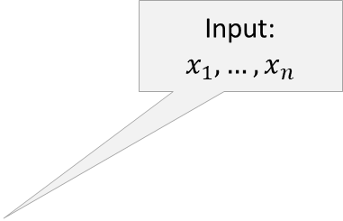
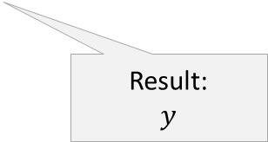
Basic software testing terminology
Input:
$$x_{1},…, x_{n}$$
Test driver
Test case 1
…
Test case n
Expectation is determined by the test oracle.
Result 1
Expectation 1
Expectation:
$$y^{∗}$$
Test object
…
…
Result n
Expectation n
Test oracle is (usually) derived from the specification
Result:
$$y$$

Slide 49

Important but imperfect
Testing shows the presence, not the absence of bugs
Many different quality aspects can be tested:
Functional errors
Performance errors
Buffer overflows
Usabillity problems
Robustness issues
Hardware errors
API usage problems
Edsger W. Dijkstra 1969

Slide 50
Correctness of machine learning from a software engineering perspective
Notes:
(8 min)

Slide 51
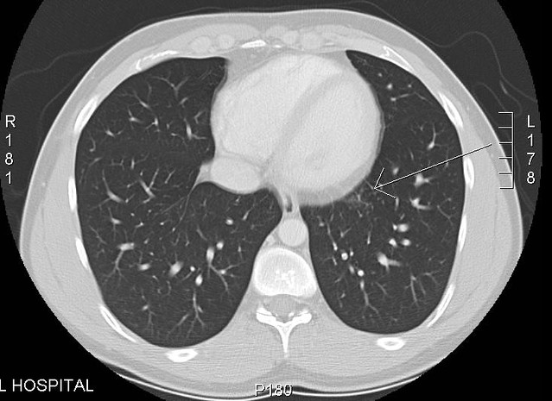
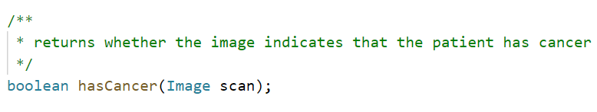
Verification and validation of prediction tasks
Cancer
No cancer
Model
How do we know the expected output?!
… no clear specification, rules unknown, instead only assumptions on expected behavior

Slide 52
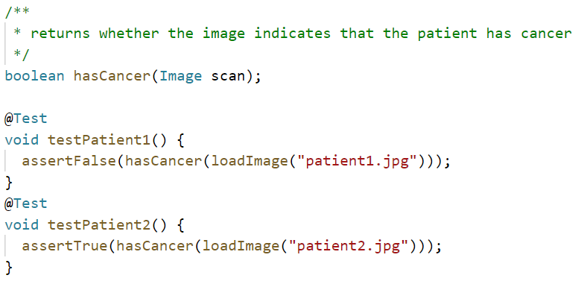
Naive approach: Just write some unit tests
What does a test failure mean!?
Unless we expect 100% accuracy, some test failures are expected!

Slide 53
Weak correctness assumption
Often no reliable ground truth
Human judgement may be biased
Humans may disagree
Problems may even have multiple acceptable solutions
We must accept that mistakes happen
We should still minimize the mistakes
However, we must consider economics and feasibility
Maybe further improvement not possible (without a huge budget and years of development)
Maybe system already good enough
We can expect to be better, the more similar our production data is to our training data

Slide 54
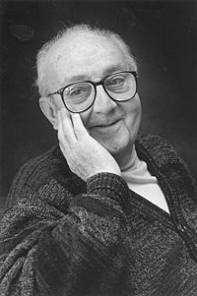
All models are wrong, but some models are useful!
All models are approximations. Assumptions, whether implied or clearly stated, are never exactly true.
All models are wrong, but some models are useful.
So the question you need to ask is not "Is the model true?" (it never is) but "Is the model good enough for this particular application?
George Box
https://en.wikipedia.org/wiki/George_E._P._Box#/media/File:GeorgeEPBox.jpg

Slide 55
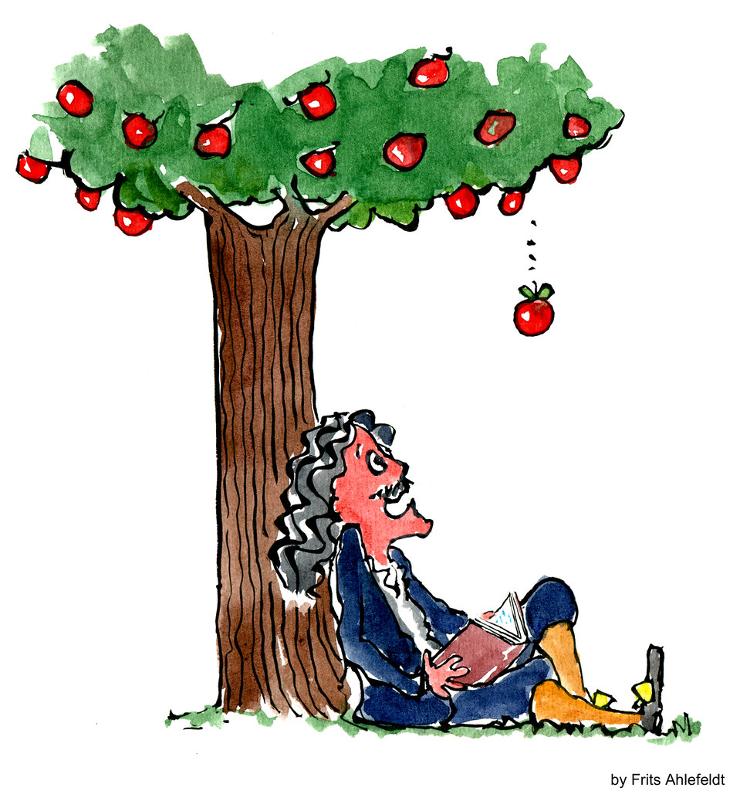
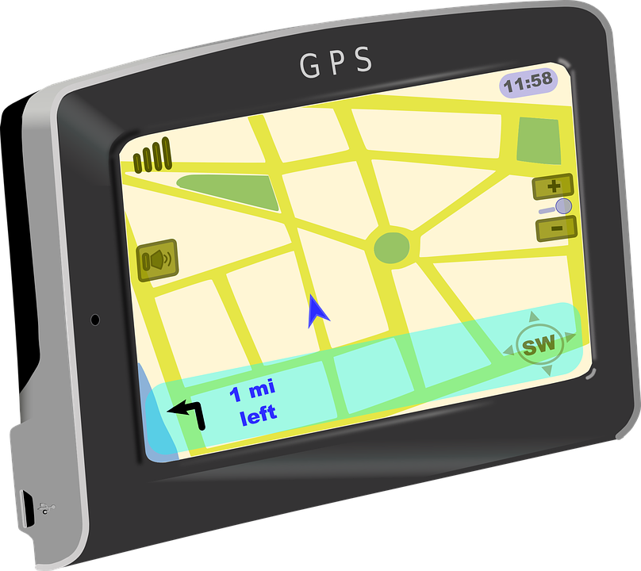
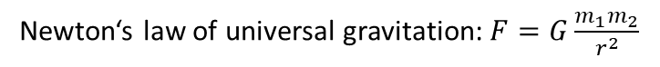
Also the case beyond ML
Newton‘s law of universal gravitation: $F=G\frac{m_{1}m_{2}}{r^{2}}$
Very good model for normal situations
Inaccurate for extreme situations, e.g., very small scales, very high speeds, or very strong gravitation

Slide 56
All models are wrong, so we must be aware of it
Since all models are wrong, the scientist cannot obtain a "correct" one by excessive elaboration. On the contrary following William of Occam he should seek an economical description of natural phenomena.
Since all models are wrong, the scientist must be alert to what is importantly wrong. It is inappropriate to be concerned about mice when there are tigers abroad.
George Box
https://en.wikipedia.org/wiki/George_E._P._Box#/media/File:GeorgeEPBox.jpg

Slide 57
Models must have utility, to be useful, even if they are wrong
Cancer
No cancer
Model
Can sometimes be wrong
… but not too often
Similar to accuracy!
… especially not when missing cancer!
False negative: no treatment. False positive: more tests to confirm.

Slide 58
Machine learning models fit, or not
A model is learned for given data with a given procedure
The learning process is typically ignored when considering model correctness
The model is generated, implementation issues are typically ignored
Shifts correctness concerns from implementation to other issues!
Is the data representative? Is there enough data? Is the data quality sufficient?
Does the model learn meaningful concepts?
Is the model useful for the purpose? Does it fit the data?
Do model predictions usually fit users‘ expectations?
Is the model consistent with other requirements?
E.g., fairness, robustness, privacy, …

Slide 59
The typical software engineering view on correctness
Software engineers almost never assure correctness
Testing finds bugs, but does not assure correctness
Formal verification can assure correctness
Expensive and restricted to high-stakes applications
Interaction between components and the environment often at least as much of a challenge
Hard to specify, many options
Good enough typical for software engineering!
Fit for purpose is software engineering goal, not correctness!

Slide 60
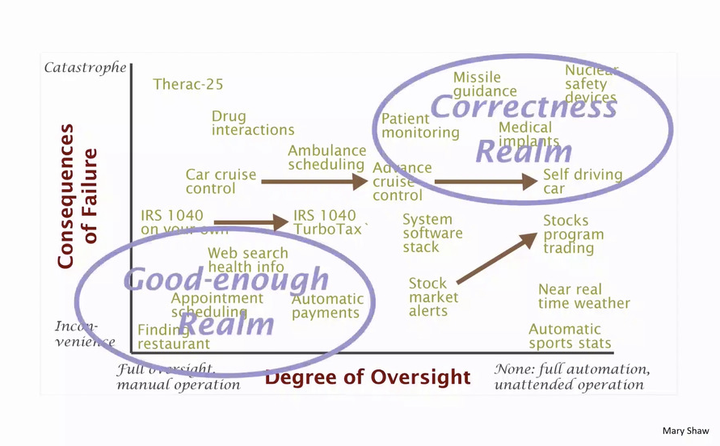
Required model quality depends on application
Mary Shaw. Myths and Mythconceptions: What does it mean to be a programming language, anyhow? HOPL IV: History of Programming Languages, 2021.

Slide 61
Some terminology
Avoid the term model bug
The meaning of this term is unclear and it may mean multiple things, e.g.
An incorrect model
A correct model that has a bug in is implementation (e.g., bad numerics)
Any other sort of misbehavior that can be attributed to the model
Performance, accuracy, goodness of fit (or just fit) are usually better terms to describe model quality than correctness
Testing has multiple meanings, i.e., software testing vs. determination of model performance
Must be obvious from the context or clarified
Verification vs. validation helps to guide process, but terms are often mixed up
May require longer explanations of the terms to avoid misunderstandings

Slide 62
Learning from software testing
Notes:
(8 min)

Slide 63
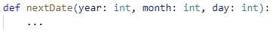

Writing tests
Simple function:
Possible tests:
Live exercise:
How do we define and select good tests?
How many tests do we need to feel confident that the function is not broken?

Slide 64
Software test case design
Opportunistic/exploratory testing
Add some (unit) tests without much planning
Specification-based testing (black box testing)
Derive test cases from specification
Equivalence classes, boundary value analysis, combinatorial testing, random testing, …
Structural testing (white box testing)
Derive test cases to cover implementation paths
Line coverage, branch coverage, data flow testing, modified condition/decision coverage, …
Test execution ideally automated, but can be manual as well
Automated generation from specification or code possible
Depends on type of tests and formality of code/specification

Slide 65

Example for deriving tests
Equivalence classes for day:
$day∈\left\{1, …, 27\right\}$
$day=28$
$day=29$
$day=30$
$day=31$
Equivalence classes for month:
$month∈\left\{1, 3, 5, 7, 8, 10, 12\right\}$
$month∈\left\{4, 6, 9, 11\right\}$
$month=2$
Equivalence classes for year
$year∈\left\{leap years\right\}$
$year∈\{not leap years\}$
Equivalence class analysis
Pick one value from each group, combine groups from variables, determine output
Boundary value analysis
Pick minimum, minimum+1, some middle value, maximum-1 and maximum from each group
If reasonable include invalid values minimum-1 and maximum+1

Slide 66
Representativeness of validation data
Target data
Validation data
Random sample
Is this representative?
Is this suitable for software testing?

Slide 67

Not all inputs are equal
Racist equivalence classes?
There Is a Racial Divide in Speech-Recognition Systems, Researchers Say: Technology from Amazon, Apple, Google, IBM and Microsoft misidentified 35 percent of words from people who were black. White people fared much better.
https://www.nytimes.com/2020/03/23/technology/speech-recognition-bias-apple-amazon-google.html

Slide 68


Random mistakes vs. rare but biased mistake
Door camera automatically detects if somebody is there
Spam detection has almost no false positives
… but only for people taller than 150 cm
… but filters all real alerts from your bank
Consider separate evaluations for important subpopulations!
Monitor mistakes in production to uncover issues!

Slide 69
Identify important inputs
Curate validation data for specific problems and subpopulations
Regression testing
Validation data for important inputs
High accuracy, must not get worse over time
Uniformness/fairness testing
Separate validation data for subpopulations (e.g., accents, types of emails)
All groups should achieve comparable accuracy
Setting goals
Validation data with difficult cases that are optional to be handled correctly (e.g., correct spelling of all names)
Low accuracy acceptable
All sets should be derived from the requirements on the system!
→ Specification-based testing!

Slide 70
Input partitioning
Accuracy within subgroups (→ uniformness and fairness testing)
Can also be relevant for business objectives!
A customer that brings ten times the revenues is more important than the average customer
Achieved by slicing data based on population criteria
Interactions between slices also need to be considered!
Goal:
Identify problems
Plan mitigations
Mitigation may also be accepting (and reporting!) lower confidence in results for a subgroup

Slide 71
Live exercise: Input partitioning for cancer prediction
What would be relevant slices?
What would you expect/require for the slices?

Slide 72
Input partitioning example: Movie review prediction
DECADE | Support | Accuracy
1910s | 38 | 78.94
1930s | 338 | 87.87
1990s | 3007 | 90.95
2000s | 6192 | 91.40
Low accuracy, but also only a small amount of data (support) for old movies
MAIN_GENRE | RAT_CAT | LEN_CAT | Support | Accuracy
Mystery | OK | Long | 11 | 72.72
Fantasy | OK | Short | 36 | 77.77
Crime | OK | Long | 100 | 81.00
Comedy | GOOD | Long | 55 | 96.36
Accuracy and support for more complex slices also differ
Barash, Guy, Eitan Farchi, Ilan Jayaraman, Orna Raz, Rachel Tzoref-Brill, and Marcel Zalmanovici. "Bridging the gap between ML solutions and their business requirements using feature interactions." In Proc. Symposium on the Foundations of Software Engineering, pp. 1048-1058. 2019.

Slide 73

Model improvement at Apple with Overton
Human focus on data and slices
AutoML approach for creating model
Christopher Ré, Feng Niu, Pallavi Gudipati, Charles Srisuwananukorn. “Overton: A Data System for Monitoring and Improving Machine-Learned Products.” Proc. of the Conference on Innovative Data Systems Research, 2020.

Slide 74
Testing model capabilities
Check if model can represent abstract concepts
Examples for sentiment mining concepts
Negations
Robustness to typos
Dealing with synonyms and abbreviations
Ignoring irrelevant information
…
Create validation data for individual capabilities
Multiple examples for each capability
Manually or following patterns
Ribeiro, Marco Tulio, Tongshuang Wu, Carlos Guestrin, and Sameer Singh. "Beyond Accuracy: Behavioral Testing of NLP Models with CheckList." In Proceedings ACL, p. 4902–4912. (2020).

Slide 75
Example: Robustness of sentiments
Evaluate if the model contains the expected invariants
Appending randomly generated handles or URLs should not affect sentiment
@JetBlue that selfie was extreme @aslkdj
@united stuck because staff took a break? Not happy … https://t.co/eqwe
Small typos through swapping characters should not affect sentiment
@JetBlue@JeBtlue that selfie was extreme @aslkdj
@SouthwestAir no thanksthakns
Switching locations should not change sentiment
@JetBlue I want you guys to be first to fly to #CubaCanada
@VirginAmerica I miss the #nerdbird in San JoseDenver
Switching person names should not change sentiment
… Airport agents were horrendous. SharonErin was our savior
@united 8602947, JonSean at http://t.co/58tuTgli0D, thanks.
Ribeiro, Marco Tulio, Tongshuang Wu, Carlos Guestrin, and Sameer Singh. "Beyond Accuracy: Behavioral Testing of NLP Models with CheckList." In Proceedings ACL, p. 4902–4912. (2020).

Slide 76
Example: Negation capabilites
Evaluate if the model handles negation of words as expected
Negated negative should be positive or neutral
The food is not poor
It isn’t a lousy customer service
Negated neutral should still be neutral
This aircraft is not private.
This is not an international flight.
Negation of negative at the end should be positive or neutral
I thought the plane would be awful, but it wasn‘t.
I though I would dislike that plane, but I didn‘t.
Negated positive with neutral content in the middle should be negative
I wouldn‘t say, given it‘s a Tuesday, that this pilot was great.
I don’t think, given my history with airplanes, that this is an amazing staff.

Slide 77
Live exercise: What are capabilities of the cancer classifier?
Invariants?
Expectations regarding predictions?

Slide 78


Usually not fair to expect generalization beyond training distribution

Slide 79

Testing capabilities may help with generalization
Capability $≈$ “partial specification” that is independent of training data
Tests encode domain knowledge about the problem
Capabilities are inherently domain specific
Curating capability specific test data may be problematic / expensive
Testing for capabilities helps identify shortcuts
Only works if the shortcut is not present in curated data!
Helps to build trust in the model beyond training data

Slide 80
Strategies for identifying capabilities
Analyze common mistakes
E.g., manually analyze past mistakes to find patterns
Use existing knowledge about the problem
E.g., about natural language or the problem domain
Observe humans at the task
E.g., consider the aspects that radiologists look for in MRIs
Derive from fairness requirements
E.g., location should not have an effect on sentiment (bias)
…

Slide 81

Generating test data for capabilites: Domain-specific generators
Uses curated negations, verbs, and things to generate many examples of negative statements.
I {NEGATION} {POSITIVE_VERB} the {THING}.
Combines foreign texture with shape to test if the model focuses on shape or texture
Geirhos, Robert, Patricia Rubisch, Claudio Michaelis, Matthias Bethge, Felix A. Wichmann, and Wieland Brendel. “ImageNet-trained CNNs are biased towards texture; increasing shape bias improves accuracy and robustness.” In Proc. International Conference on Learning Representations (ICLR), (2019)

Slide 82


Generating test data for capabilities: Mutating existing inputs
E.g., synonyms, distractions, noise

Slide 83

Generating test data for capabilities: Crowd-sourcing test generation
Ask humans to modify data
Example: minimally change sentence to flip the sentiment with sarcasm
The world of Atlantis, hidden beneath the earth‘s core, is fantastic!
The world of Atlantis, hidden beneath the earth‘s core, is “fantastic”!
Ask humans to generate data
Andrei Barbu, David Mayo, Julian Alverio, William Luo, Christopher Wang, Dan Gutfreund, Josh Tenenbaum, and Boris Katz. Objectnet: A large-scale bias-controlled dataset for pushing the limits of object recognition models. In Advances in Neural Information Processing Systems 32, pages 9448–9458. 2019.

Slide 84

Generating test data for capabilities: Slicing test data
Find slices of input containing “not”
Find slices of input that are very bright/dark
…

Slide 85
Testing vs. training capabilities
Insights regarding capabilities relevant for both testing and training
Capabilities that hold during testing should also hold during training
If capabilities do not hold during testing, we can investigate why
Overfitting during training
Underfitting during training
Capability not (often) observed during training
…
Can curate data for training to get better!

Slide 86
The oracle problem
Notes:
(8 min)

Slide 87

Random input generation is easy!
… but does it really make sense to test cancer prediction with this?!

Slide 88
Randomly generating realistic inputs often also possible
Random dates
Random texts
Randomly generated images
Randomly generated coordinates
Randomly generated driving behavior
…
How do we know the expected output?!

Slide 89
The Oracle problem
In general, we have no way to determine the expected output for an input!
→ No test oracle!

Slide 90
Test case generation and test oracles
Manual test oracle
Human constructs input-output pairs
Checking of global properties only
Crashes, overflows, code injection, …
Comparison against a gold standard
Alternative implementation, executable specification
Manually written assertions as runtime checks
Checks part of the specification at runtime

Slide 91



Manual oracle
Does not (easily) scale, no automation

Slide 92



Global properties
Only fails in case of unhandled exceptions
Effective to find severe issues!
… but ignores correctness of computed results
Herbold, S., Haar, T. Smoke testing for machine learning: simple tests to discover severe bugs. Empir Software Eng 27, 45 (2022). https://doi.org/10.1007/s10664-021-10073-7

Slide 93


Comparison against reference implementation
Fail
Input generator
System Under Test (SUT)
Comparator
Pass
Reference implementation / Gold standard
Assumes we have a correct reference implementation
… which is usually not the case for ML problems

Slide 94

Checking invariants at runtime
Assumes we can specify invariants within model execution
… unclear how this should work for ML in general

Slide 95

ML Models == Untestable Software?!
Manual test oracle
Does not scale
Checking of global properties only
Only suitable for a severe bugs
Comparison against a gold standard
Usually, no model that is always correct available
Manually written assertions as runtime checks
Unclear how to define or insert into code

Slide 96

Pseudo-oracles
Simulate real test oracles for a subset of the input-output pairs
Cannot be used to test everything, but useful for testing specific properties!
M. D. Davis and E. J. Weyuker, “Pseudo-oracles for non-testable programs,” in Proceedings of the ACM ’81 Conference,

Slide 97
Pseudo-oracles with metamorphic testing
Notes:
(8 min)

Slide 98








Metamorphic testing for machine learning
Define transformation (morphism) $g$ for input to specify invariant
Check invariant relationship between of $f\left(x\right)$ and $f(g(x))$ as test oracle
Original data
$$x$$
Original output
$$f(x)$$
Morphism for input
Compare
$$g$$
Model
Morphed output
$$f$$
$$f\left(g(x\right))$$
Morphed data
$$g(x)$$

Slide 99

We have already used this!

Slide 100

Domain-specific invariants
Similar to what we considered earlier
Credit rating should not be affected by gender
Applies to: $x∈data$
Morphism: $g\left(x\right)=\left\{\begin{matrix}x\left[gender=male\right] if x.gender=female \\ x\left[gender=female\right] if x.gender=male\end{matrix}\right.$
Expected relationship: $f\left(g\left(x\right)\right)=f(x)$
Less income should not lead to a better credit rating
Applies to: $x∈data, x.income≥1$
Morphism: $g\left(x\right)=x[income=x.income−1]$
Expected relationship: $f\left(g\left(x\right)\right)≤f(x)$
…
$x[y=z]$ denotes that the feature $y$ of the instance $x$ is set to $z$ without changing any other feature
$x.y$ denotes the value of feature $y$ of the instance $x$

Slide 101


Robustness-related invariants
Check if outcome fulfills some smoothness property with relation to training data
Tiny modifications of training data should not change results
Applies to: $x∈data$
Morphism: $g\left(x\right)=x+ε$ for a sufficiently small feature vector $ε$ with ${\left|\left|ε\right|\right|}_{2}<δ, δ>0, δ∈ℝ$
Expected relationship: $f\left(g\left(x\right)\right)=f\left(x\right)$
Model output in region around training data within a certain range
Applies to: $x∈data$
Morphism: $g\left(x\right)=x+ε$ for a feature vector $ε$ with ${\left|\left|ε\right|\right|}_{2}<δ, δ>0, δ∈ℝ$
Expected relationship: $MIN≤f\left(g (x)\right)≤MAX$
…
Result does not change in a ball around each instance within the data
$$δ$$
No extreme values are observed for data sufficiently similar to data

Slide 102
Approaches for defining metamorphic tests
Generate random test data
Usually easy
Should be generated to avoid error hiding
If the data is extreme and something fails, failure may be related to data (e.g., numeric issues), not property
Unclear if data or property the reason for the error
Transform existing training, validation, and/or test data
Adversarial learning
Gradient-based search for invariant violations
Formal verification of invariants is an open research problem
Works, e.g., for simple constraints and small neural networks

Slide 103
Acting on invariant violations
Usually based on weak correctness assumption
Some violations are usually unavoidable
Sometimes strict requirements regarding violations
Safety
Fairness, robustness
Representativeness of data relevant for deciding how to act
Random data may not be from the target distribution → violations may not be problematic
This requires very good knowledge (or strict assumption) about the target distribution!

Slide 104
More software testing concepts
Notes:
(8 min)

Slide 105

Test coverage
Measures how many lines/statements/decisions/… are executed (=covered) by the tests
Test effort driven by the structure of the source code!
https://www.jacoco.org/jacoco/trunk/coverage/

Slide 106
Structural testing (aka white box testing, glass box testing)
Typically aims to increase the coverage of tests
Concept can also be applied to ML models
Does the test data cover all paths in a decision tree?
Are all neurons in a deep neural network activated at least once?
Not always well defined
Linear regression?!
Support Vector Machine?!
Naive Bayes?!
Automated generation of data to cover models possible
Data often not realistic → unclear how useful this is
Can be combined with adversarial learning to get more meaningful results

Slide 107
Regression testing
For every bug, add a test case
Increases likelihood that new bugs within the same code (so called regressions) are caught
Execute regression tests after changes to find defects early
Ideally with continuous integration tools (e.g., nightly, for every commit, or for every pull request)
Maps well to curating test data for ML
Especially useful for important populations and invariants!

Slide 108
Mutation analysis (aka mutation testing)
Start with a working program (i.e., a program that passes it‘s test suite)
Automatically insert small modifications (mutation)
a+b → a-b
a<b → a<=b
…
Check if test suite detects the modification
“Kills” the mutant
Better test suites kill more mutants (mutation score)
Early research exists
E.g., mutate model parameters (e.g., weights) or inputs
Often combined with coverage criteria
Practical usefulness and applications still unclear

Slide 109

Continuous Integration (CI)
Automatically build and test software in case of changes

Slide 110

Works well to monitor changes of ML models
Michelangelo for the exploration of model performance for different builds
Jeremy Hermann and Mike Del Balso. Meet Michelangelo: Uber’s Machine Learning Platform. Blog, 2017 https://eng.uber.com/michelangelo-machine-learning-platform/

Slide 111
Dashboards for build and version comparison
Matei Zaharia. Introducing MLflow: an Open Source Machine Learning Platform, 2018 https://databricks.com/blog/2018/06/05/introducing-mlflow-an-open-source-machine-learning-platform.html

Slide 112

Specialized CI systems
Can automatically check for model regressions or if improvements are as expected
→ Special type of directly integrated test case!
Renggli et. al, Continuous Integration of Machine Learning Models with ease.ml/ci: Towards a Rigorous Yet Practical Treatment, SysML 2019

Slide 113
Questions?

